Slide 1
EIE 411 Computer Organization and Architecture
MODULE 04 B: STORAGE & INPUT/OUTPUT SYSTEM
Part B: Computer Bus Structure

Slide 2
Introduction
Basic Bus Structure
Internal Bus
External Bus

Slide 3
Introduction
In computer architecture, a bus is a communication system that transfers data between components inside a computer, or between computers. This covers all related hardware components (wire, optical fiber, etc.) and software, including communication protocols.
Early computer buses were parallel electrical wires with multiple connections. Modern computer buses can use both parallel and bit serial connections.
The most common type of connection is a Universal Serial Bus (USB). Many peripheral devices, such as printers and scanners, use a USB connection.

Slide 4
Introduction
The speed of a bus is measured in megahertz (MHz). The faster the bus, the faster data is communicated. The speed of the motherboard is defined by the bus speed.
Buses are limited by their width in bits. They are usually 8, 16 or 32-bits wide. This tells us how many bits can be sent by the bus at any one time, or example a 32-bit bus can send 32 bits at once.

Slide 5
System Bus
Computer systems generally consist of three main parts: the central processing unit (CPU) that processes data, memory that holds the programs and data to be processed, and I/O (input/output) devices as peripherals that communicate with the outside world.
The bus connecting the CPU, memory, and I/O, is one of the defining characteristics of the system, and often referred to as the system bus.
The most critical connection of any computer system is the system bus. This is a single computer bus that controls the transfers between the CPU, the main memory, and the input/output devices.

Slide 6
System Bus
A system bus is a single computer bus that connects the major components of a computer system.
The technique was developed to reduce cost. It combines the functions of a data bus to carry information, an address bus to determine where it should be sent, and a control bus to determine its operation.

Slide 7
System Bus
The system bus carries three types of information: address, data, and control. The address information describes where data is located and where it needs to go during a particular operation. The data are the actual digital pieces of information that need to be transferred. The control information manages the flow of the address and data information, including the direction of the transfer and exactly how data needs to be routed through the computer system.

Slide 8
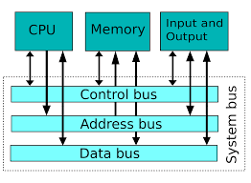
System Bus

Slide 9
Data Bus
Function of a data bus is to send data from one device to another
Data is passed by a parallel or serial method
Buses can be parallel buses, which carry data words in parallel on multiple wires, or serial buses, which carry data in bit-serial form.
– Parallel will normally pass in a multiple of 8- bits at a time
Parallel data bus is faster
– Serial passes one bit at a time

Slide 10
Data Bus

Slide 11
Address Bus
For example, if the CPU needs to read an instruction (data) from a given location in memory
Identify the source or destination of data
Bus width determines maximum memory capacity of a system.

Slide 12
Address Bus

Slide 13
Control Lines
Controls the access to the data and address lines
Controls the use of the data and address lines
Typical control lines include the following:
Memory write
Memory read
I/O write

Slide 14
Control Lines
I/O read
Transfer ACK
Bus request
Bus grant
Interrupt request
Interrupt ACK
Clock
Reset

Slide 15
Bus Type
Dedicated – Separate data & address lines
Multiplexed – Shared lines – Address valid or data valid control line
Advantage - fewer lines
Disadvantage – More complex

Slide 16
Internal Bus
The internal bus, also known as internal data bus, memory bus, system bus or Front-Side-Bus, connects all the internal components of a computer, such as CPU and memory, to the motherboard. Internal data buses are also referred to as a local bus, because they are intended to connect to local devices. This bus is typically rather quick and is independent of the rest of the computer operations.

Slide 17
External Bus
The external bus, or expansion bus, is made up of the electronic pathways that connect the different external devices, such as printer etc., to the computer.

Slide 18
INTERNAL AND EXTERNAL BUSES

Slide 19
PCI
Peripheral Component Interconnection
An example of an internal parallel bus
High bandwidth
Intel released to public domain
32 or 64 bit
50 lines @ 66 MHz
Transfer Rate of 528MB/s

Slide 20
SCSI
Small Computer System Interface.
A high-speed, intelligent peripheral I/O bus with a device independent protocol. It allows different peripheral devices and hosts to be interconnected on the same bus. Depending on the type of SCSI, you may have up to 8 or 16 devices connected to the SCSI bus.
There is a large variety of peripheral devices available for SCSI, including hard disk drives, floppy drives, CDs, optical storage devices, tape drives, printers and scanners to name a few.

Slide 21
SCSI
SCSI-1
SCSI-2
Wide SCSI
Fast SCSI
Fast Wide SCSI
Ultra SCSI
SCSI-3
Ultra2 SCSI
Wide Ultra2 SCSI

Slide 22
ATA (IDE, EIDE)
The Parallel ATA standard is the result of a long history of incremental technical development, which began with the original AT Attachment interface.
The ATA interface itself evolved in several stages from Western Digital's original Integrated Drive Electronics (IDE) interface to Extended IDE (EIDE) and Ultra ATA (UATA).

Slide 23
SCSI vs. ATA (IDE, EIDE)
SCSI does not utilize the CPU for data transfer management.
SCSI is more expensive than EIDE
SCSI can handle more devices

Slide 24
SCSI vs. ATA (IDE, EIDE)
Fibre Channel, or FC, is a high-speed network technology (commonly running at 2-, 4-, 8- and 16-gigabit per second rates) primarily used to connect computer data storage.
Fibre Channel is standardized in the T11 Technical Committee of the International Committee for Information Technology Standards (INCITS).

Slide 25
Fibre Channel
Fibre Channel is an open T11 and ANSI standards-based block-oriented serial network protocol that brings together some of the best features of the channel world and the network world.
Fibre Channel is full-duplex (Full duplex means that data can travel in both directions simultaneously.), and offers a variety of different cabling options.

Slide 26
Advantages of Fibre Channel
Reliable – it is reliable with assured information delivery
Gigabit bit rate – 1.06 Gbps, scalable to 2.12 Gbps and 4.24 Gbps
Multiple topologies – it has dedicated point-to- point, shared loops, and scaled switched topologies meet application requirements

Slide 27
Advantages of Fibre Channel
Multiple protocols – it supports SCSI, TCP/IP, video, or raw data , and is especially suited to real-time video/audio.
Scalable – it supports single point-to- point gigabit links to integrated enterprises with hundreds of servers.
Congestion Free – data can be sent as fast as the destination buffer can receive it.
Highly efficient

Slide 28
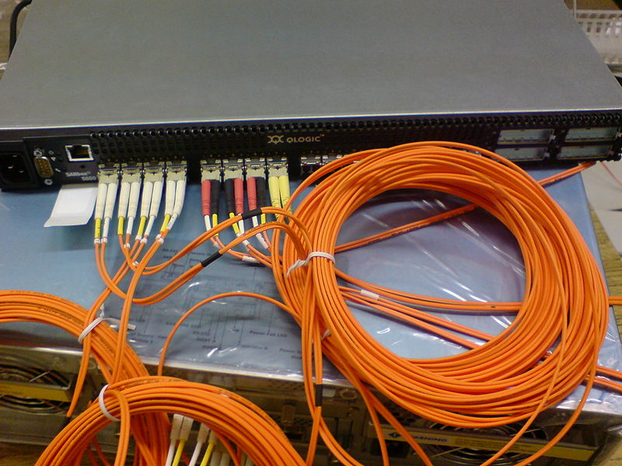
Fibre Channel Switch

Slide 29


